Slide 1


Analyzing Delivery Efficiency: The Pizza Case Study
By mohd wasi

Slide 2
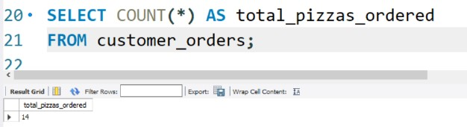
How many pizzas were ordered?

Slide 3
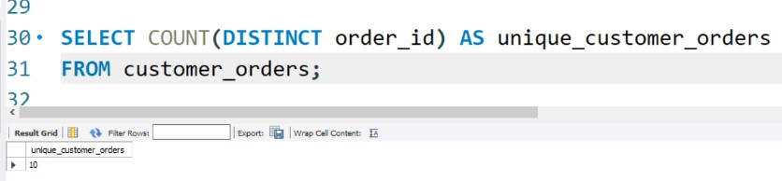
How many unique customer orders were made?

Slide 4
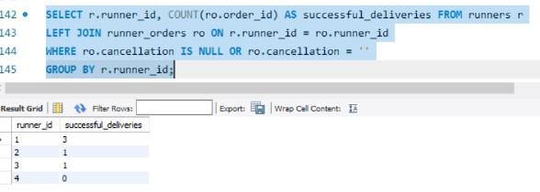
How many successful orders were delivered by each runner?

Slide 5
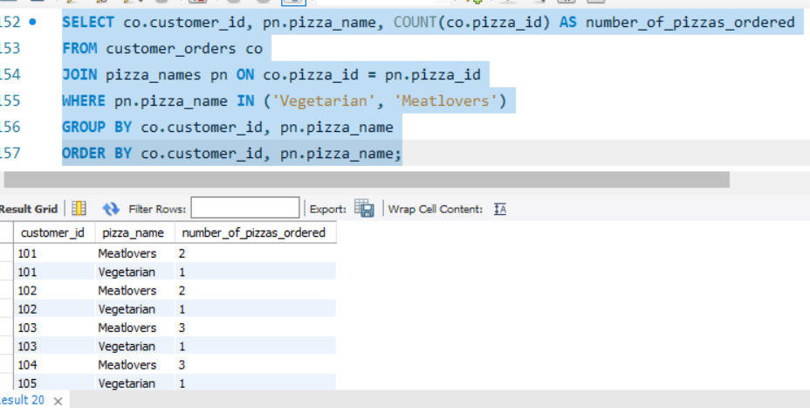
How many Vegetarian and Meatlovers were ordered by each customer?

Slide 6
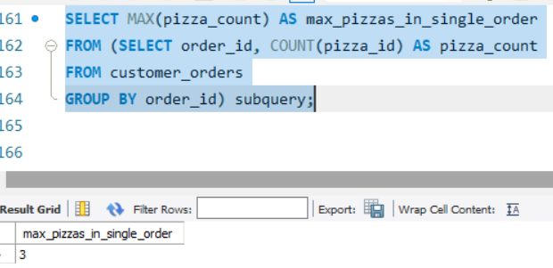
What was the maximum number of pizzas delivered in a single order?

Slide 7
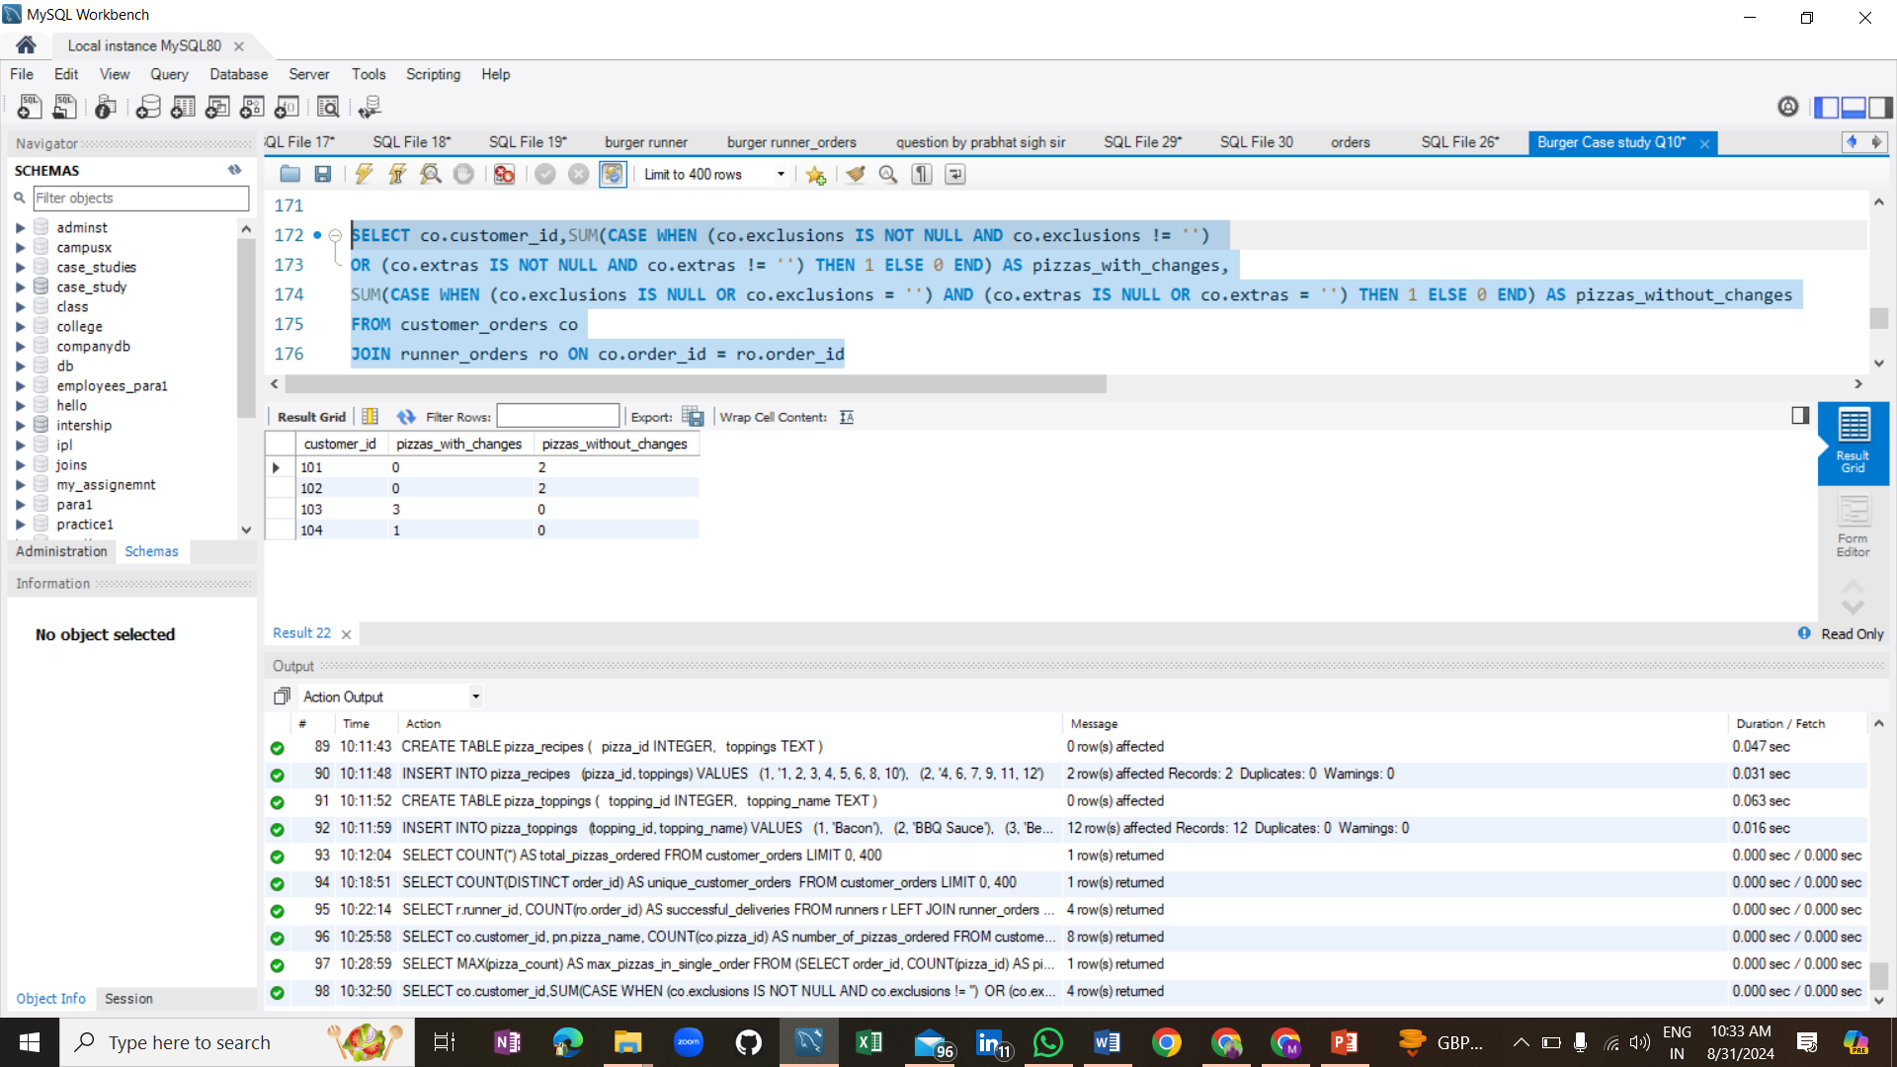
For each customer, how many delivered pizzas had at least 1 change and how many had no changes?

Slide 8
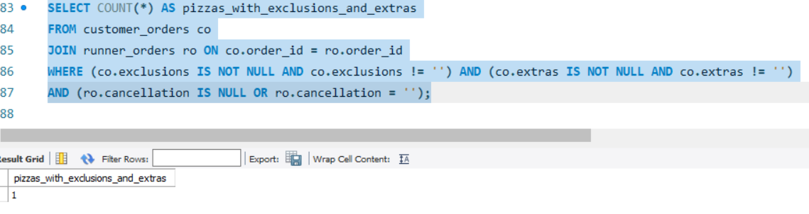
How many pizzas were delivered that had both exclusions and extras?

Slide 9
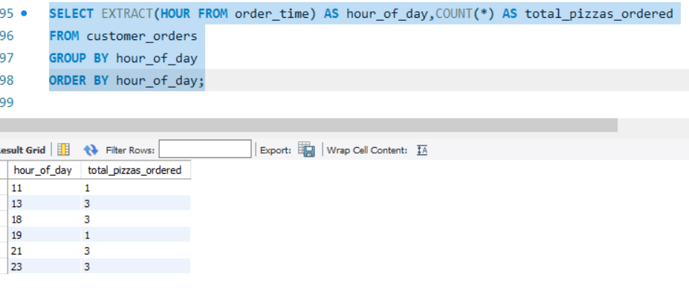
What was the total volume of pizzas ordered for each hour of the day?

Slide 10
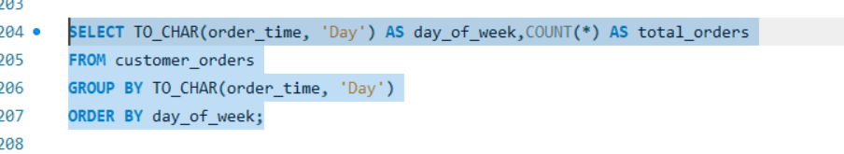
What was the volume of orders for each day of the week?

Slide 11
Insights
Total Pizzas Ordered: 14 pizzas.
Unique Orders: 10 unique customer orders.
Runner Deliveries: Runner 1 delivered 5 orders, Runner 2 delivered 3, and Runner 3 delivered1.
Pizza Types Delivered: 9 Meatlovers, 4 Vegetarian.
Customer Orders with Changes: Customers 103 and 104 had 4 pizzas with changes; Customers 101, 102, and 105 had 6 pizzas with no changes.
* Peak Order Times: Most pizzas ordered at 18:00 (4 pizzas) and 21:00 (3 pizzas).

